Slide 1

CHAPTER 9:
DATA WAREHOUSING
Modern Database Management
11th Edition
Jeffrey A. Hoffer, V. Ramesh,
Heikki Topi
© 2013 Pearson Education, Inc. Publishing as Prentice Hall

Slide 2
OBJECTIVES
Define terms
Explore reasons for information gap between information needs and availability
Understand reasons for need of data warehousing
Describe three levels of data warehouse architectures
Describe two components of star schema
Estimate fact table size
Design a data mart
Develop requirements for a data mart

Slide 3
DEFINITIONS
Data Warehouse
  A subject-oriented, integrated, time-variant, non-updatable collection of data used in support of management decision-making processes
    Subject-oriented: e.g. customers, patients, students, products
    Integrated: consistent naming conventions, formats, encoding structures; from multiple data sources
    Time-variant: can study trends and changes
    Non-updatable: read-only, periodically refreshed
Data Mart
  A data warehouse that is limited in scope

Slide 4
HISTORY LEADING TO DATA WAREHOUSING
Improvement in database technologies, especially relational DBMSs
Advances in computer hardware, including mass storage and parallel architectures
Emergence of end-user computing with powerful interfaces and tools
Advances in middleware, enabling heterogeneous database connectivity
Recognition of difference between operational and informational systems

Slide 5
NEED FOR DATA WAREHOUSING
Integrated, company-wide view of high-quality information (from disparate databases)
Separation of operational and informational systems and data (for improved performance)

Slide 6
ISSUES WITH COMPANY-WIDE VIEW
Inconsistent key structures
Synonyms
Free-form vs. structured fields
Inconsistent data values
Missing data
  See figure 9-1 for example

Slide 7
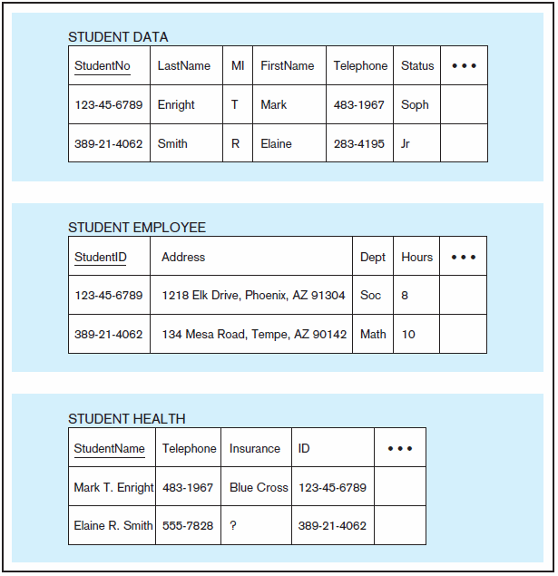
Figure 9-1 Examples of heterogeneous data
Chapter 9
© 2013 Pearson Education, Inc. Publishing as Prentice Hall

Slide 8
ORGANIZATIONAL TRENDS MOTIVATING DATA WAREHOUSES
No single system of records
Multiple systems not synchronized
Organizational need to analyze activities in a balanced way
Customer relationship management
Supplier relationship management

Slide 9
SEPARATING OPERATIONAL AND INFORMATIONAL SYSTEMS
Operational system – a system that is used to run a business in real time, based on current data; also called a system of record
Informational system – a system designed to support decision making based on historical point-in-time and prediction data for complex queries or data-mining applications

Slide 10
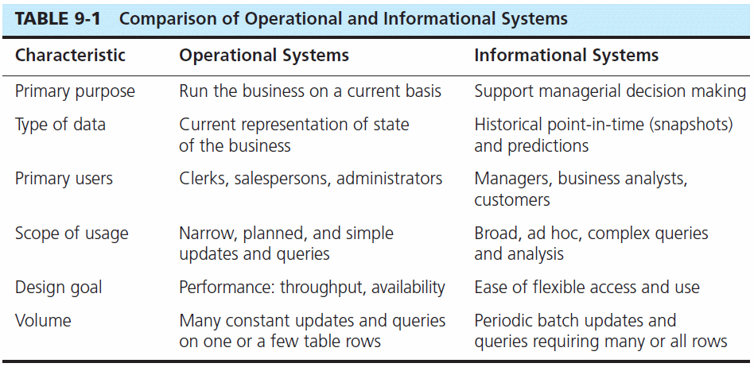

Slide 11
DATA WAREHOUSE ARCHITECTURES
Independent Data Mart
Dependent Data Mart and Operational Data Store
Logical Data Mart and Real-Time Data Warehouse
Three-Layer architecture
All involve some form of extract, transform and load (ETL)

Slide 12
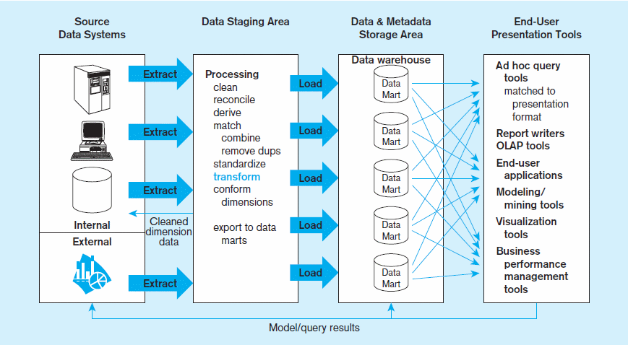
Figure 9-2 Independent data mart data warehousing architecture
Data marts:
Mini-warehouses, limited in scope
L
T
E
Separate ETL for each independent data mart
Data access complexity due to multiple data marts
Chapter 9
© 2013 Pearson Education, Inc. Publishing as Prentice Hall

Slide 13
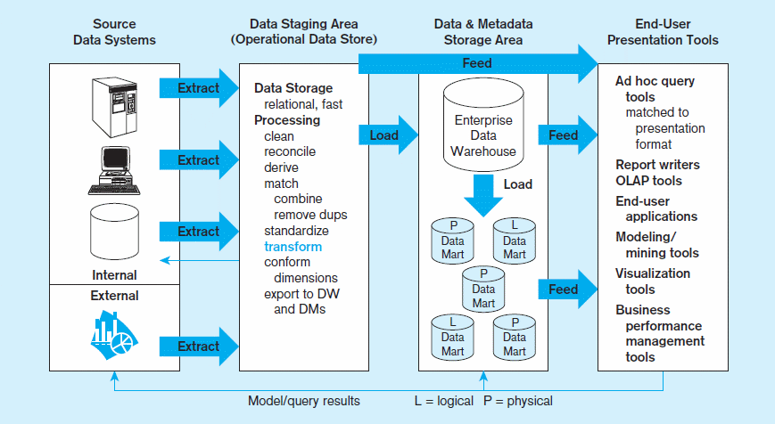
Figure 9-3 Dependent data mart with operational data store: a three-level architecture
ODS provides option for obtaining current data
L
T
E
Simpler data access
Single ETL for
enterprise data warehouse (EDW)
Dependent data marts loaded from EDW
Chapter 9
© 2013 Pearson Education, Inc. Publishing as Prentice Hall

Slide 14
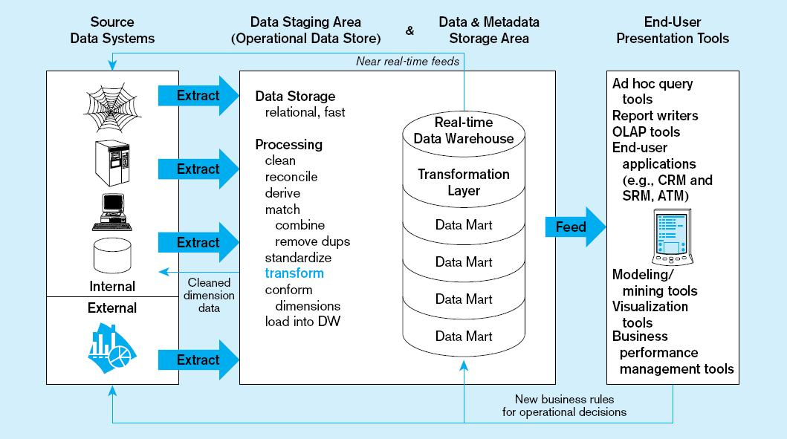
Figure 9-4 Logical data mart and real time warehouse architecture
ODS and data warehouse are one and the same
L
T
E
Near real-time ETL for
Data Warehouse
Data marts are NOT separate databases, but logical views of the data warehouse
➔ Easier to create new data marts
Chapter 9
© 2013 Pearson Education, Inc. Publishing as Prentice Hall

Slide 15
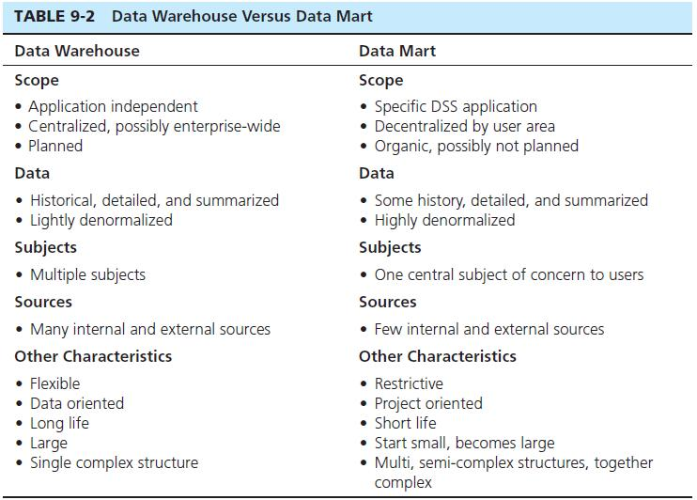
Chapter 9
© 2013 Pearson Education, Inc. Publishing as Prentice Hall

Slide 16
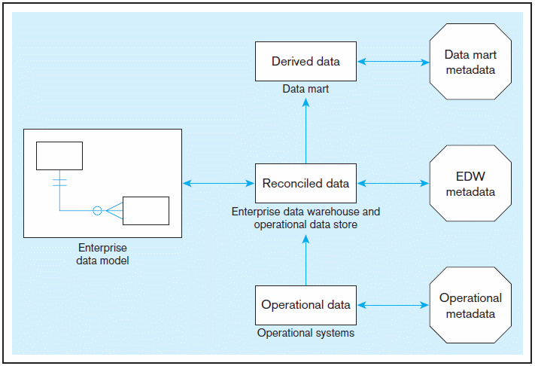
Figure 9-5 Three-layer data architecture for a data warehouse
Chapter 9
© 2013 Pearson Education, Inc. Publishing as Prentice Hall

Slide 17
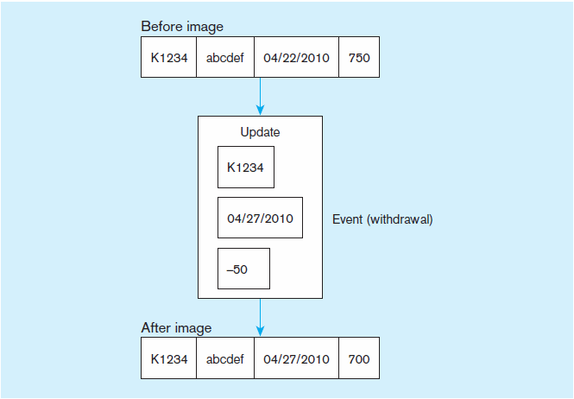
DATA CHARACTERISTICS
STATUS VS. EVENT DATA
Figure 9-6 Example of DBMS log entry
Status
Event = a database action (create/ update/ delete) that results from a transaction
Status

Slide 18
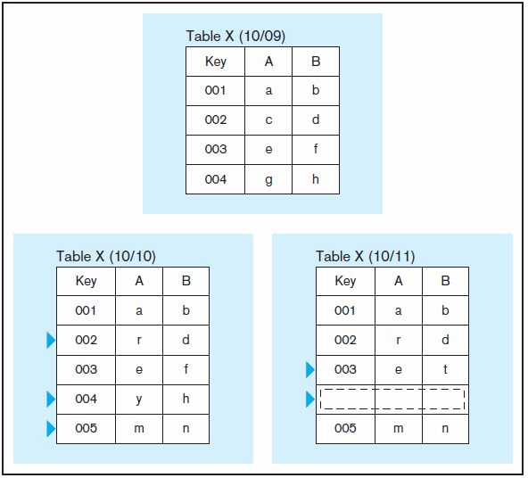
DATA CHARACTERISTICS
STATUS VS. EVENT DATA
Figure 9-7 Transient operational data
With transient data, changes to existing records are written over previous records, thus destroying the previous data content.

Slide 19
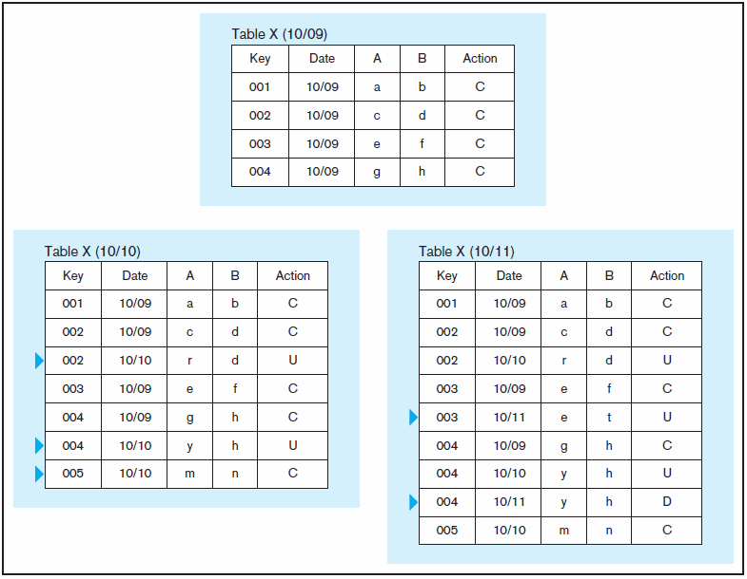
DATA CHARACTERISTICS
STATUS VS. EVENT DATA
Figure 9-8 Periodic warehouse data
Periodic data are never physically altered or deleted once they have been added to the store.

Slide 20
OTHER DATA WAREHOUSE CHANGES
New descriptive attributes
New business activity attributes
New classes of descriptive attributes
Descriptive attributes become more refined
Descriptive data are related to one another
New source of data

Slide 21
DERIVED DATA
Objectives
  Ease of use for decision support applications
  Fast response to predefined user queries
  Customized data for particular target audiences
  Ad-hoc query support
  Data mining capabilities
Characteristics
  Detailed (mostly periodic) data
  Aggregate (for summary)
  Distributed (to departmental servers)
Most common data model = dimensional model
(usually implemented as a star schema)

Slide 22
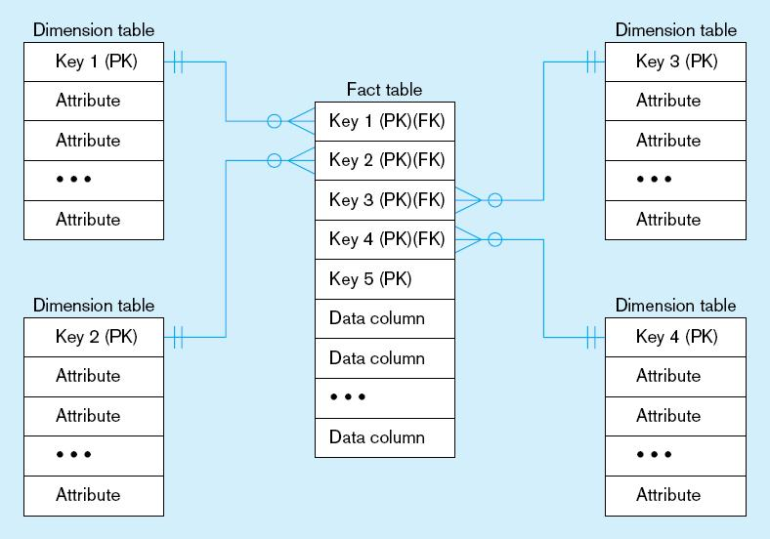
Figure 9-9 Components of a star schema
Fact tables contain factual or quantitative data
1:N relationship between dimension tables and fact tables
Dimension tables are denormalized to maximize performance
Dimension tables contain descriptions about the subjects of the business
Excellent for ad-hoc queries, but bad for online transaction processing
Chapter 9
© 2013 Pearson Education, Inc. Publishing as Prentice Hall

Slide 23
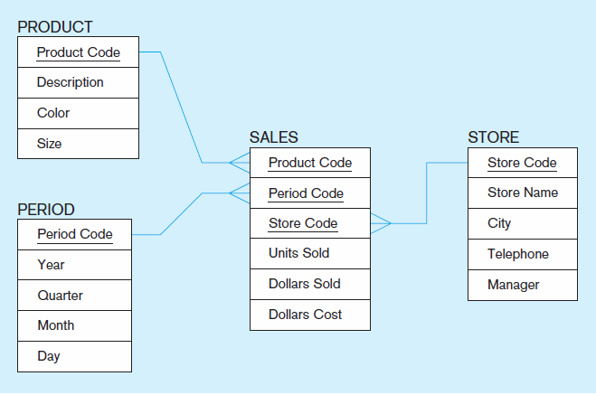
Figure 9-10 Star schema example
Fact table provides statistics for sales broken down by product, period and store dimensions
Chapter 9
© 2013 Pearson Education, Inc. Publishing as Prentice Hall

Slide 24
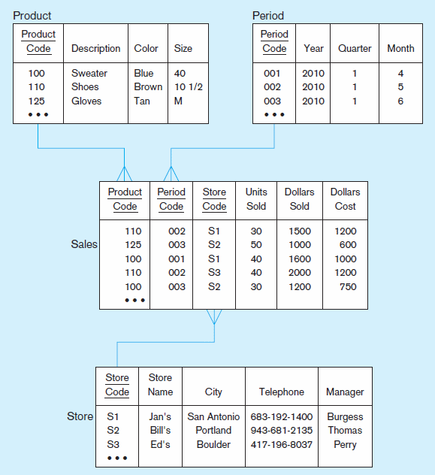
Figure 9-11 Star schema with sample data
Chapter 9
© 2013 Pearson Education, Inc. Publishing as Prentice Hall

Slide 25
SURROGATE KEYS
Dimension table keys should be surrogate (non-intelligent and non-business related), because:
  Business keys may change over time
  Helps keep track of nonkey attribute values for a given production key
  Surrogate keys are simpler and shorter
  Surrogate keys can be same length and format for all key

Slide 26
GRAIN OF THE FACT TABLE
Granularity of Fact Table–what level of detail do you want?
  Transactional grain–finest level
  Aggregated grain–more summarized
  Finer grains ➔ better market basket analysis capability
  Finer grain ➔ more dimension tables, more rows in fact table
  In Web-based commerce, finest granularity is a click

Slide 27
DURATION OF THE DATABASE
  Natural duration–13 months or 5 quarters
  Financial institutions may need longer duration
  Older data is more difficult to source and cleanse

Slide 28

SIZE OF FACT TABLE
Depends on the number of dimensions and the grain of the fact table
Number of rows = product of number of possible values for each dimension associated with the fact table
Example: Assume the following for Figure 9-11:
Total rows calculated as follows (assuming only half the products record sales for a given month):

Slide 29
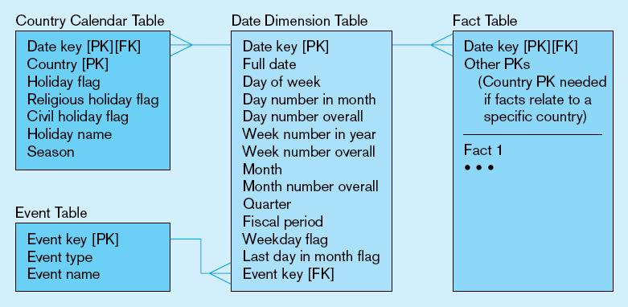
Figure 9-12 Modeling dates
Fact tables contain time-period data
➔ Date dimensions are important

Slide 30
VARIATIONS OF THE STAR SCHEMA
Multiple Facts Tables
  Can improve performance
  Often used to store facts for different combinations of dimensions
  Conformed dimensions
Factless Facts Tables
  No nonkey data, but foreign keys for associated dimensions
  Used for:
    Tracking events
    Inventory coverage

Slide 31
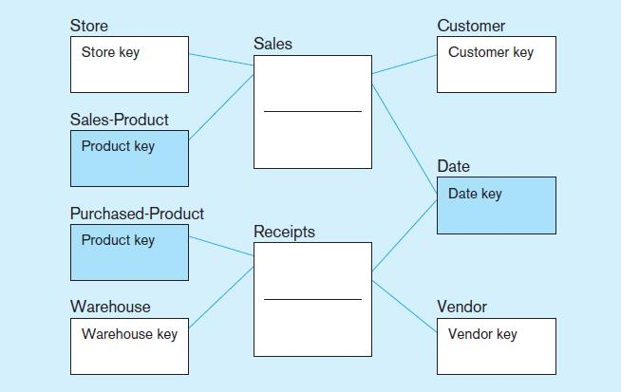
Figure 9-13 Conformed dimensions
Two fact tables ➔ two (connected) start schemas.
Conformed dimension Associated with multiple fact tables

Slide 32
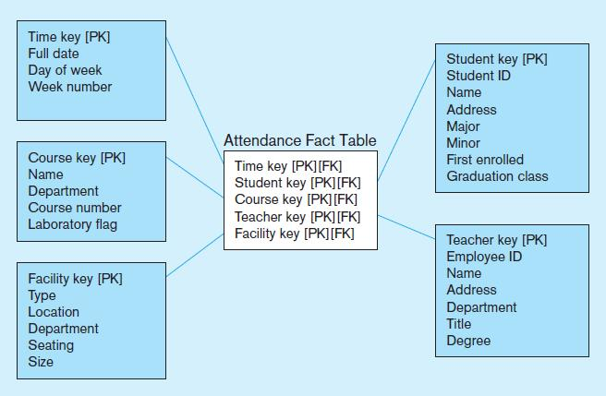
Figure 9-14a Factless fact table showing occurrence of an event
No data in fact table, just keys associating dimension records
Fact table forms an n-ary relationship between dimensions

Slide 33
NORMALIZING DIMENSION TABLES
Multivalued Dimensions
  Facts qualified by a set of values for the same business subject
  Normalization involves creating a table for an associative entity between dimensions
Hierarchies
  Sometimes a dimension forms a natural, fixed depth hierarchy
  Design options
    Include all information for each level in a single denormalized table
    Normalize the dimension into a nested set of 1:M table relationships

Slide 34
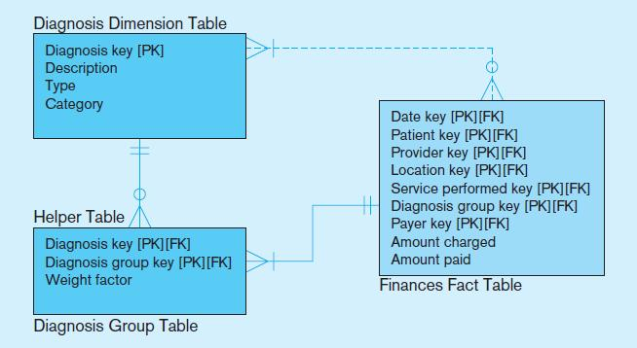
Figure 9-15 Multivalued dimension
Helper table is an associative entity that implements a M:N relationship between dimension and fact.

Slide 35
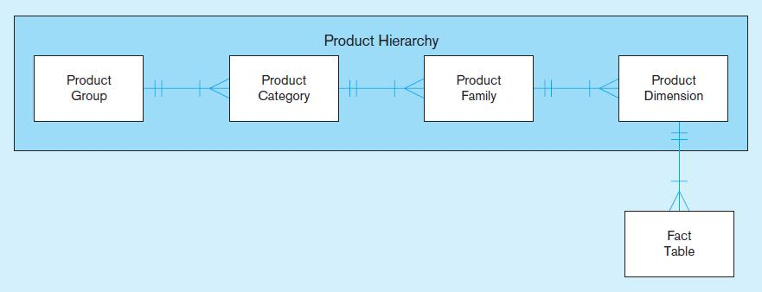
Figure 9-16 Fixed product hierarchy
Dimension hierarchies help to provide levels of aggregation for users wanting summary information in a data warehouse.

Slide 36
SLOWLY CHANGING DIMENSIONS (SCD)
How to maintain knowledge of the past
Kimble’s approaches:
  Type 1: just replace old data with new (lose historical data)
  Type 2: for each changing attribute, create a current value field and several old-valued fields (multivalued)
  Type 3: create a new dimension table row each time the dimension object changes, with all dimension characteristics at the time of change. Most common approach

Slide 37
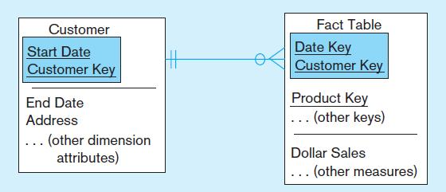

Figure 9-18 Example of Type 2 SCD Customer dimension table
The dimension table contains several records for the same customer. The specific customer record to use depends on the key and the date of the fact, which should be between start and end dates of the SCD customer record.

Slide 38
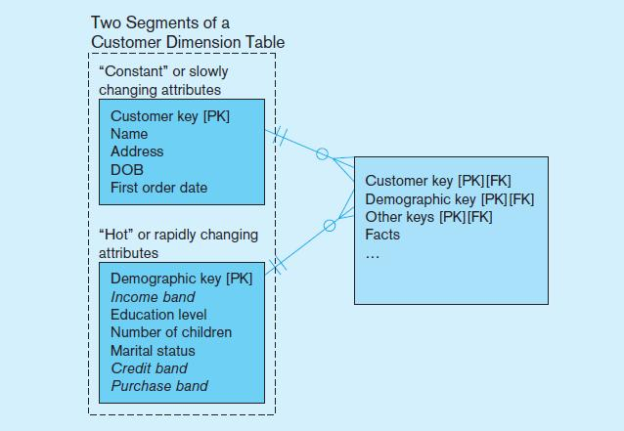
Figure 9-19 Dimension segmentation
For rapidly changing attributes (hot attributes), Type 2 SCD approach creates too many rows and too much redundant data. Use segmentation instead.

Slide 39
10 ESSENTIAL RULES FOR DIMENSIONAL MODELING
Use atomic facts
Create single-process fact tables
Include a date dimension for each fact table
Enforce consistent grain
Disallow null keys in fact tables
Honor hierarchies
Decode dimension tables
Use surrogate keys
Conform dimensions
Balance requirements with actual data

Slide 40
OTHER DATA WAREHOUSE ADVANCES
Columnar databases
  Issue of Big Data (huge volume, often unstructured)
  Columnar databases optimize storage for summary data of few columns (different need than OLTP)
  Data compression
  Sybase, Vertica, Infobright,
NoSQL
  “Not only SQL”
  Deals with unstructured data
  MongoDB, CouchDB, Apache Cassandra

Slide 41
THE USER INTERFACE
METADATA (DATA CATALOG)
Identify subjects of the data mart
Identify dimensions and facts
Indicate how data is derived from enterprise data warehouses, including derivation rules
Indicate how data is derived from operational data store, including derivation rules
Identify available reports and predefined queries
Identify data analysis techniques (e.g. drill-down)
Identify responsible people

Slide 42
ONLINE ANALYTICAL PROCESSING (OLAP) TOOLS
The use of a set of graphical tools that provides users with multidimensional views of their data and allows them to analyze the data using simple windowing techniques
Relational OLAP (ROLAP)
  Traditional relational representation
Multidimensional OLAP (MOLAP)
  Cube structure
OLAP Operations
  Cube slicing–come up with 2-D view of data
  Drill-down–going from summary to more detailed views

Slide 43
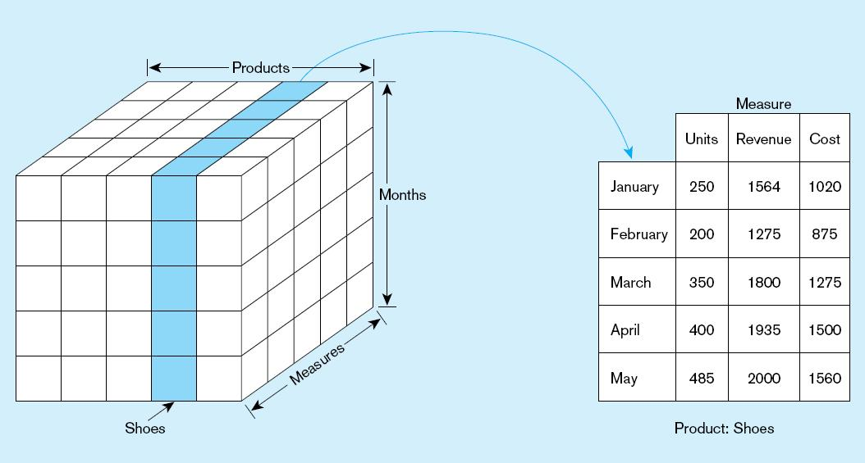
  Figure 9-21 Slicing a data cube
Chapter 9
© 2013 Pearson Education, Inc. Publishing as Prentice Hall

Slide 44
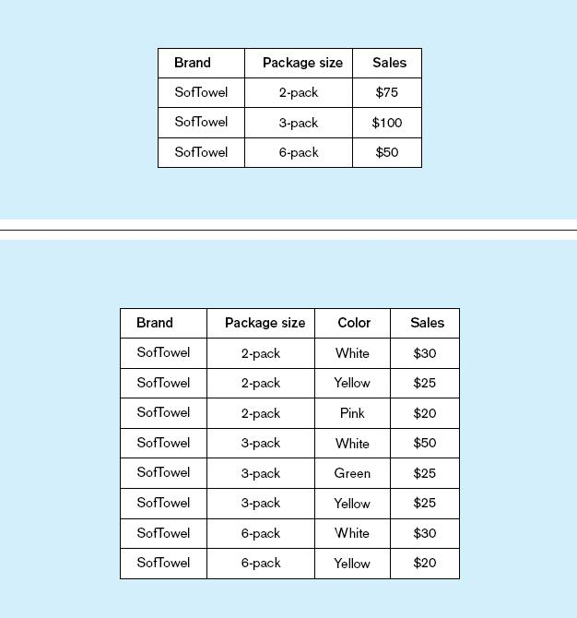
Summary report
Figure 9-22
Example of drill-down
Starting with summary data, users can obtain details for particular cells.
Drill-down with color added

Slide 45
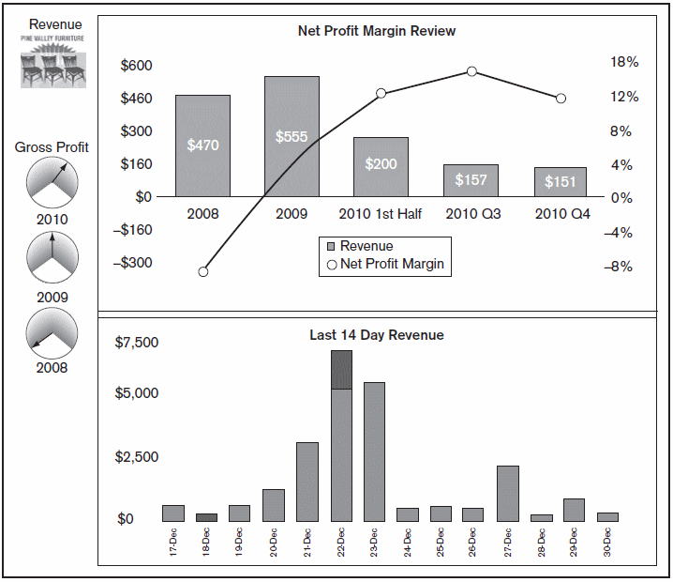
BUSINESS PERFORMANCE MGMT (BPM)
Figure 9-25
Sample Dashboard
BPM systems allow managers to measure,
monitor, and manage key activities and processes to achieve organizational goals.
Dashboards are often used to provide an information system in support of BPM.
Charts like these are examples of data visualization, the representation of data in graphical and multimedia formats for human analysis.

Slide 46
DATA MINING
Knowledge discovery using a blend of statistical, AI, and computer graphics techniques
Goals:
  Explain observed events or conditions
  Confirm hypotheses
  Explore data for new or unexpected relationships

Slide 47
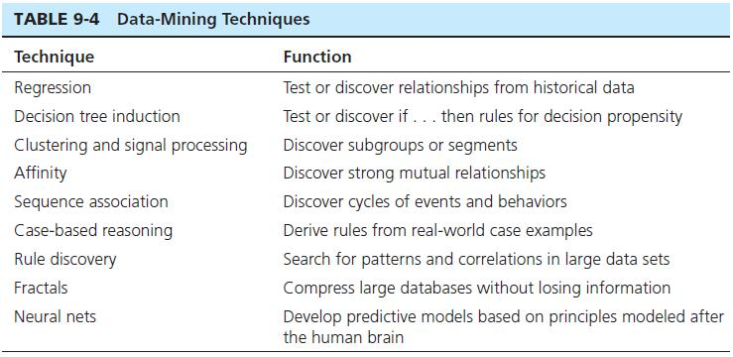
Chapter 9
© 2013 Pearson Education, Inc. Publishing as Prentice Hall

Slide 48

Copyright © 2011 Pearson Education, Inc. Publishing as Prentice Hall

